Slide 1
Farm Management Consulting
MNP Canadian Agriculture Industry Outlook Fall 2020
John Loeppky P.Ag
October 2020

Slide 2
Ag Industry Outlook – Table of Contents
Canadian Agricultural Industry Outlook 2020
  Market Fundamentals
  US Dollar – US Trade
  Poultry
  Dairy
  Crops
  Hogs
  Beef
  Wineries
  Cannabis
  Food and Beverage
Contacts
Appendices
  Our People

Slide 3
Industry Outlook 2020
The Market Fundamentals
Supply Chain Volatility/Disruption
Supply - Demand
Trade (export vs protectionist)
Supply Management

Slide 4
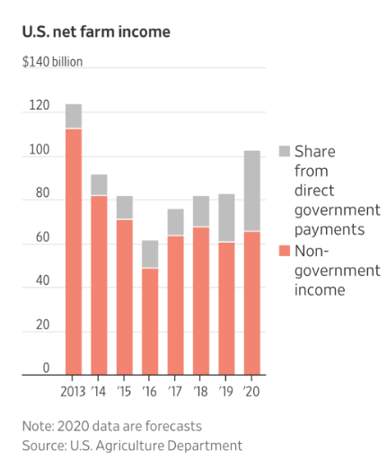
Industry Outlook 2020

Slide 5
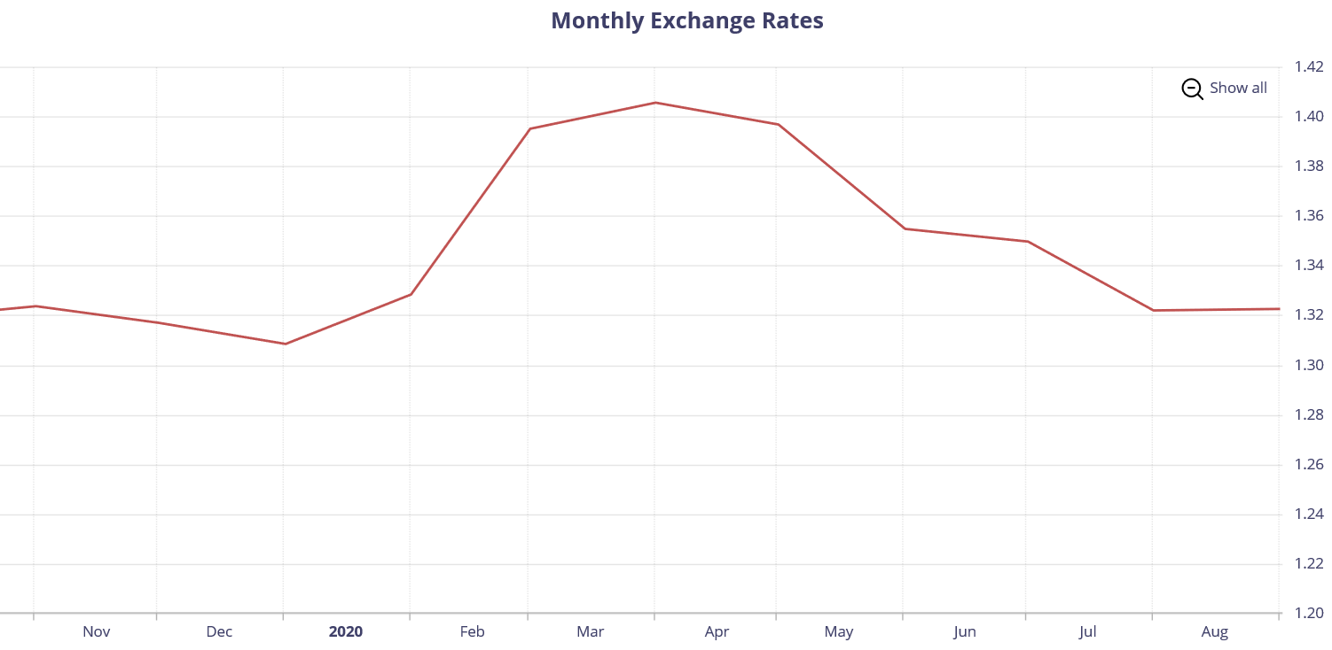
Industry Outlook 2020
Source: Bank of Canada

Slide 6
Industry Outlook 2020
USA and WTO
USA is not an advocate of the World Trade Organization
Would like to see major reform to the WTO or US withdrawal
Have been blocking appointment of judges to the appellate body that hears appeals to WTO rulings
  Without the appointments the appellate body can’t function – no appeals currently being heard

Slide 7
Industry Outlook 2020
USA and China
Phase 1 deal reached in January
  China agreed to purchase $36.6 billion of US ag products in 1st year
  To the end of Aug they have purchased $11 billion
China won its WTO case on US tariffs placed on $200 billion worth of goods
  WTO ruled the tariffs were inconsistent with international trade rules
US would like to appeal the WTO ruling
  Ironically, the US has blocked its own opportunity to appeal

Slide 8
Industry Outlook 2020
Canada and China
Diplomatic relations remain chilly, at best, following the arrest of Huawei CFO Meng Wanzhou
China retaliated by arresting two Canadian citizens on espionage charges
The canola export licenses of Richardson and Viterra were then suspended by China
  Remain suspended to this day
Free trade talks, although stalled, had not broken off until September
  Foreign Affairs Minister Francois-Phillipe Champagne says a trade deal is no longer worth pursuing.

Slide 9
Industry Outlook 2020
Canada and USA
CUSMA appears to be working out from the Canadian farmer perspective so far
Most tariff rate quotas for US dairy access to Canada have been allocated to Canadian processors
  Import raw milk components rather than processed products to go on store shelves

Slide 10
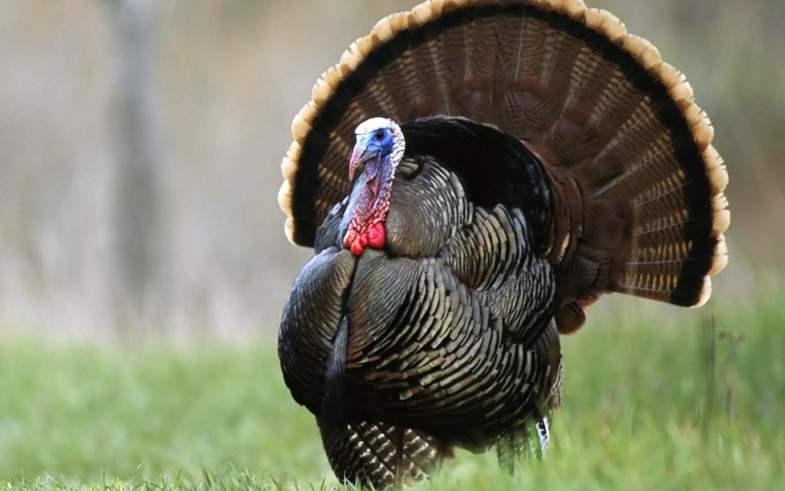
Industry Outlook 2020
Poultry
Outlook steady/good
Shifting consumer demand
Prices and consumption continue to improve
Covid-19 Impact
Safe Guards
Understand the quota:
  Provincial legislation re: transferability.
  Debtor’s utilization and options to lease out quota.
  Understanding compensation rules will have bearing on security.
High land values may support security position

Slide 11
Industry Outlook 2020
Covid Impacts
Supply Chain Disruption
  In August, 15 workers at plant in Calgary test positive
  In October, over 20 workers test positive in Manitoba plant
  Demand for smaller turkey size
    Due to reduced gathering sizes for holiday events
Demand for chicken initially shocked
  Rebounded slowly
  Hope to return to 100% production by Christmas and then taper off seasonally

Slide 12
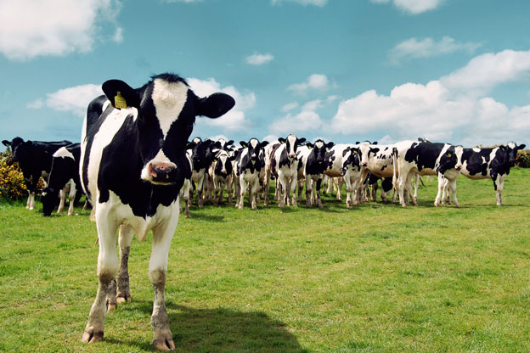
Industry Outlook 2020
Dairy
Consumer demand shifting
Quota Prices
Trade Impacts
Safe Guards
Understand the quota:
  Provincial legislation re: transferability.
  Debtor’s utilization and options to lease out quota.
  Understanding compensation rules will have bearing on security.
High land values may support security position

Slide 13
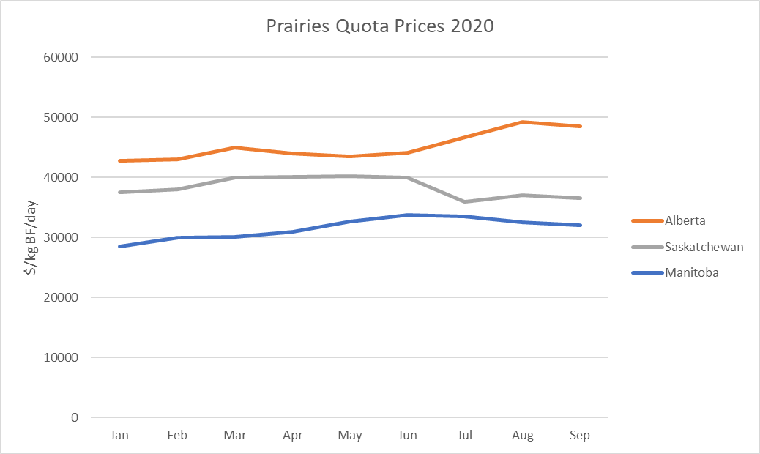
Industry Outlook 2020

Slide 14
Industry Outlook 2020
Federal Government announced $1.75 billion compensation package to the dairy industry for the market access that was given up in CETA and CPTPP
  Will be distributed over 8 years - $345 million in 2019
  No details for USMCA compensation
Source: Canadian Dairy Commission

Slide 15
Industry Outlook 2020
Crops
2020 Harvest
Crop Yields
Farm Equipment
Farmland Values
Safe Guards
Equipment ratio on grain farms is important.
Ensure all property of creditor included on debt security
Verify proper registration on land and related farm equipment
Verify crop insurance & AgriStability status

Slide 16
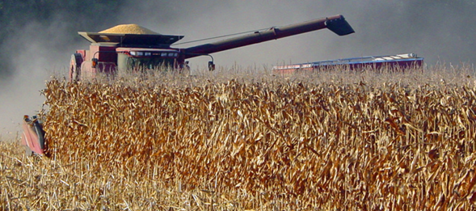
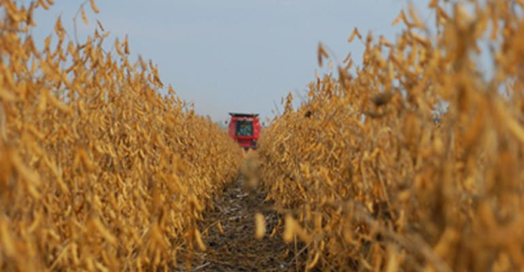
Industry Outlook 2020
USA Harvest
  Harvest nearing completion
  Back to big crops – flooding limited ‘19
  Corn: 13.7 billion bushels – 2019
    Forecasted at 14.7 billion bushels -2020
      Good conditions, quick pace
  Soybeans: 3.6 billion bushels – 2019
    Forecasted 4.3 billion bushels - 2020
      Record yield increase

Slide 17
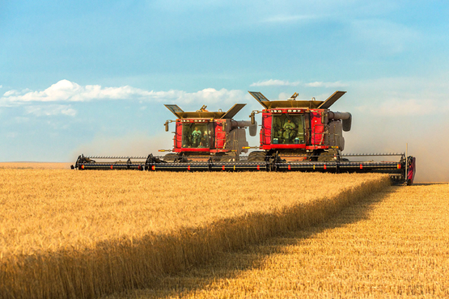
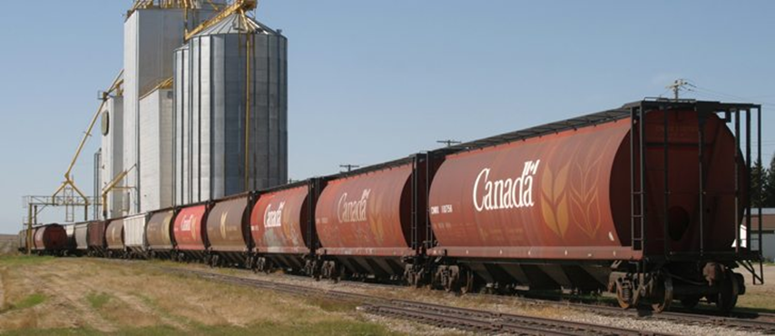
Industry Outlook 2020
Majority of grain producing areas had good harvest weather
For a change….harvest was relatively uneventful
Grain movement has been good
  More than 75% of rail cars ordered have been spotted on avg
  Wheat, oats, barley and canola are ahead of the 5-year avg for exports YTD
Better than expected yield’s reported so far given conditions
Western Canada harvest progress ahead of 5-yr avg
    AB – 90% complete as of October 6th, 2020
    SK – 96% complete as of October 6th, 2020
    MB – 88% complete as of October 6th, 2020

Slide 18

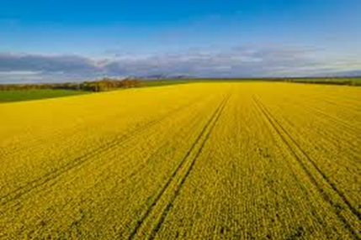
Industry Outlook 2020
Stat’s Can estimates (as of Aug 31- final report in Dec. 2020):
  Smaller soybean production – 6.1 million tonnes
    20% decrease from peak in 2017
      Bigger yields but much reduced acres
  Smallest canola production in 5 yrs – 19.4 million tonnes
    9.6% decrease from peak in 2017
      Decrease in harvested area and yield
  Second highest wheat production – 34.1 million tonnes
    4.5% increase over 2019
      Second largest acres in last 5 years

Slide 19
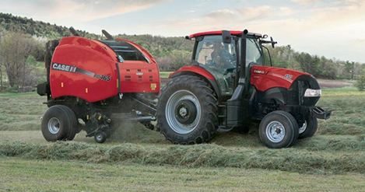
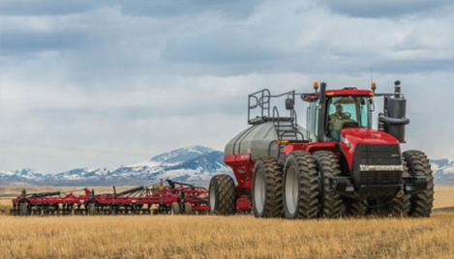
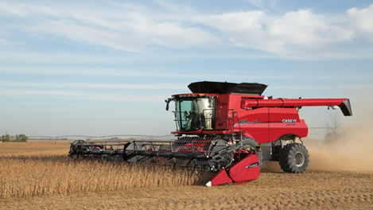
Industry Outlook 2020
Lower overall machinery purchases
2WD farm tractors up 9.4% YOY
4WD farm tractors down 11.4% YOY
Combine sales down 9.4% YOY
Source:Association of Equipment Manufacturers

Slide 20
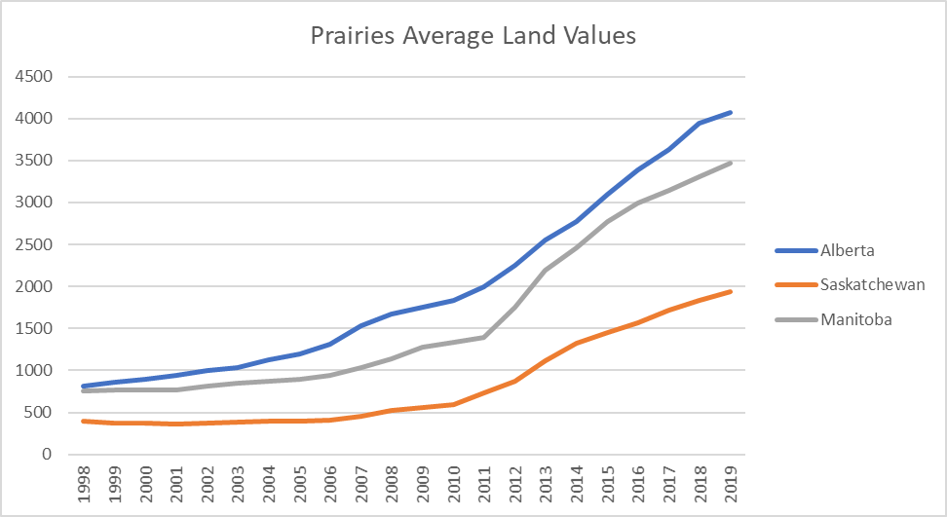
Industry Outlook 2020
Source: FCC

Slide 21
Industry Outlook 2020
Canadian farmland value up 5.2% in 2019
Expected to increase going forward
Major drivers of land prices:
  Crop income (yields and prices)
  Interest rates
Extremely low interest rate environment currently coupled with good grain prices a recipe for land values to increase again

Slide 22
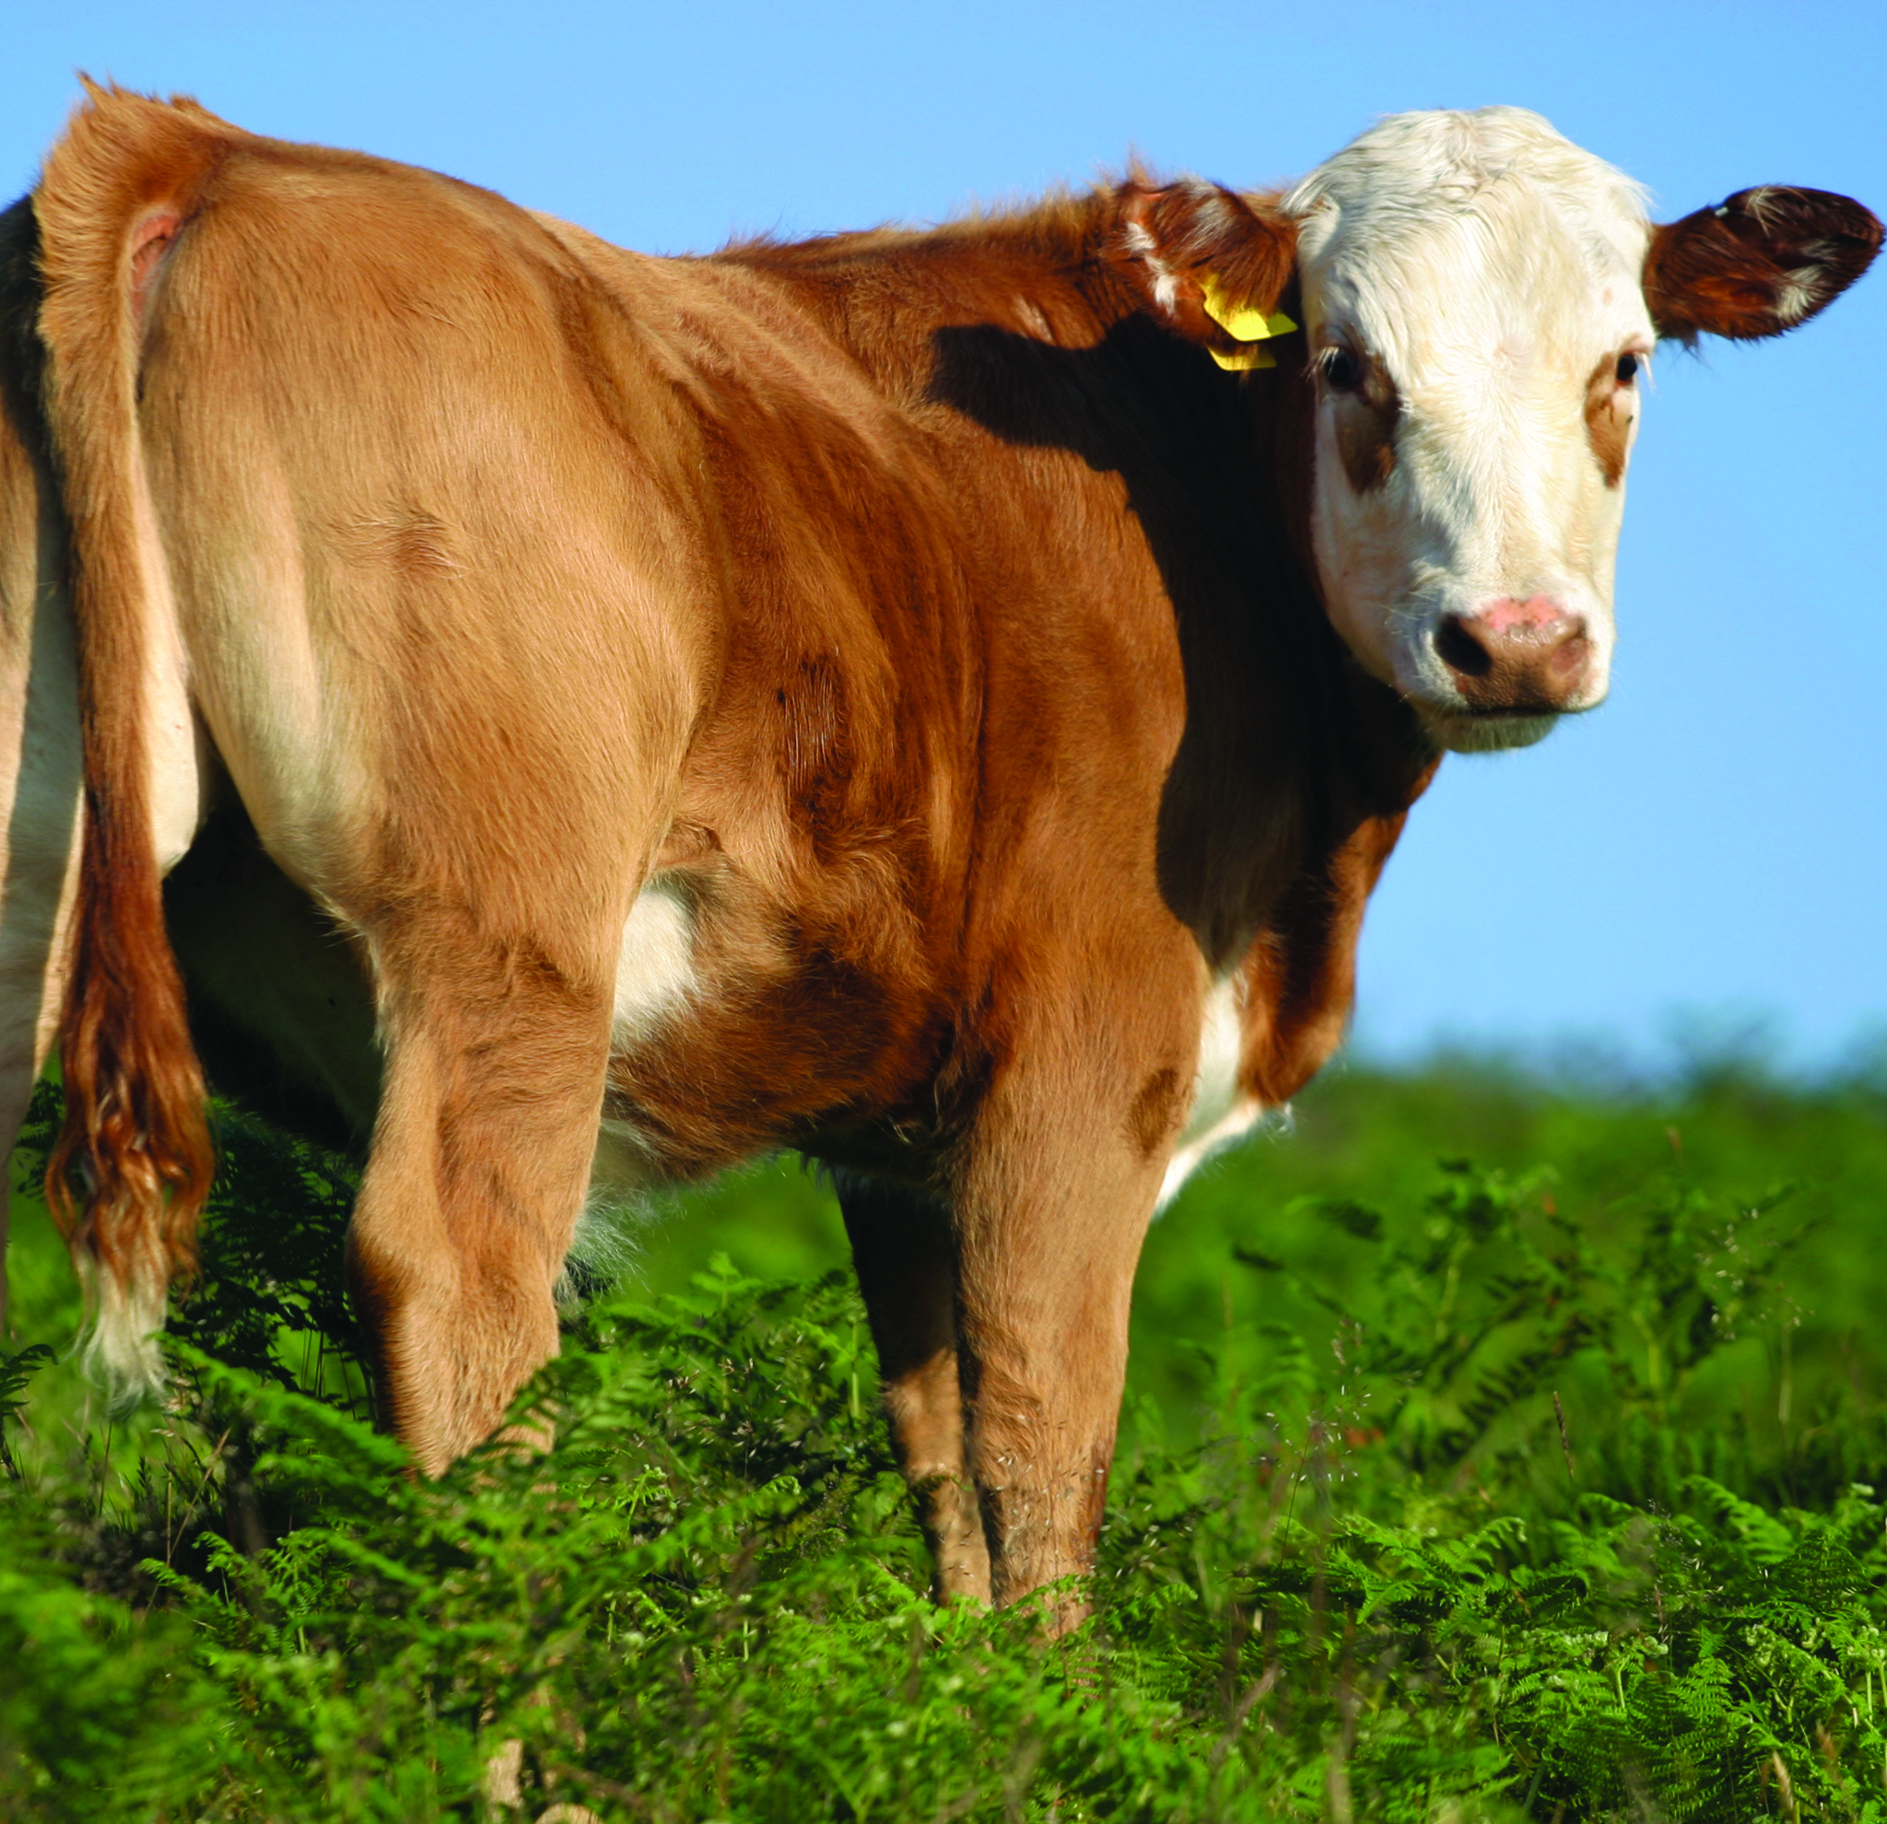
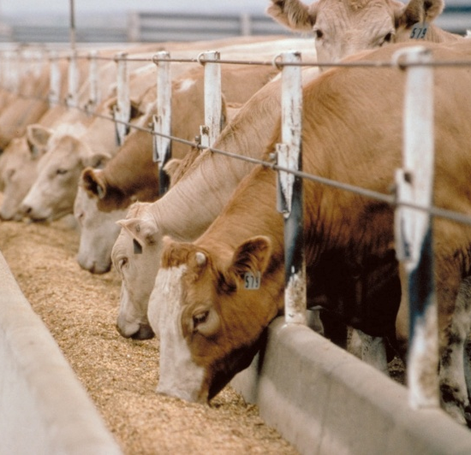

Industry Outlook 2020
Hogs
Price volatility
  Kill plant closures
Feed prices rising
Trade
  China
Disease pressure
  ASF
Safe Guards
Perform walk-through on short notice and assess condition of
herd and barn operations
Verify proper registration on land and related farm equipment
Verify AgriStability status.

Slide 23
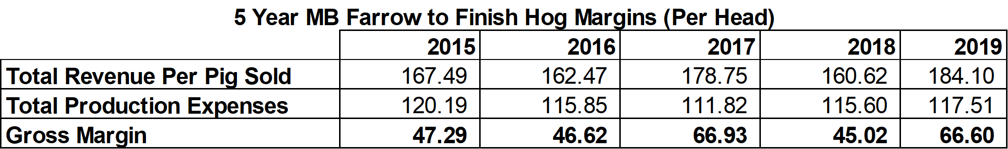
Industry Outlook 2020

Slide 24
Industry Outlook 2020
African Swine Fever - China
  China rebuilding after losing 60% of its breeding stock
  Sow numbers grew 37% year over year in August
  Rebuilt sow herd will not be as productive
    Using low quality sows to rebuild
African Swine Fever – Poland/Germany
  Poland – 97 farms and 2000 wild boar
  Germany – 38 wild boar

Slide 25
Industry Outlook 2020
Cow/Calf
Stability in Canada
Herd shrinking slightly
  0.8% decline in heifers
  1.4% decline in cows
Slow start to fall run
  Ample forage and feed grain
Safe Guards
Perform walk-through on short notice
Verify inventory and require manifests and/or proof of purchase or sale. Look closely at inventory values.
Verify AgriStability and risk management practices.

Slide 26
Industry Outlook 2020
Feedlots
Temporary plant closures
Feed prices trending up
Gov’t programs
  AB, SK,MB,ON set-aside program
Safe Guards
Verify inventory and require manifests and/or proof of
purchase or sale
Verify AgriStability status and CPIP contracts
Ensure lands properly captured in loan documents and
registered at land titles
Check risk management practices. Scrutinise business plans.

Slide 27

Industry Outlook 2020
Wineries
Wine sales up at retail but down at restaurant/bars
Agritourism down sharply
Exports
Safe Guards
Verify Inventory (and value in-use).- sample to ensure quality.
Confirm terms of licences to produce and sell are being met.
Seek rolling 5 year plans/third-party input – primary downfall is cash and
inventory management.

Slide 28
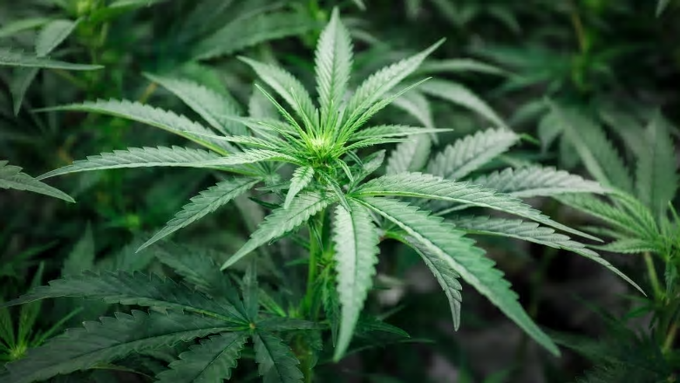
Industry Outlook 2020
Cannabis
Retail sales increasing
  Changing price point
Commoditization
Joint Ventures with Food and Beverage
Safe Guards
Ensure all property of creditor included on debt security.
Confirm terms of licences to produce and sell are being met.
Confirm key individuals named in licences are tied to the company.

Slide 29

Industry Outlook 2020
Food and Beverage
Margins are getting squeezed
  Look to reduce Energy, Water, Waste
Labour shortage
Access to PPE
Safe Guards
Ensure all property of creditor included on debt security.
Confirm terms of licences to produce and sell are being met.
Confirm key individuals named in licences are tied to the company.
Notes:
FX – barriers right now are access to capital to meet growing demand and access to human resources to produce product.
Trade – all good for this industry – further processed goods is a huge opportunity for Canada right now. TPP, CETA. USMCA all net positive for Food and Beverage
Industry is a priority for Gov’t right now
clustering strategy
funding/grants for innovation and technology are a priority
2nd largest mfg sector in Canada is Food and Beverage – centered in Ontario and Quebec
Trend toward assembled and packaged food in grocery stores– take home and prepare/take home and heat/take home and eat
seen in larger centres right now/trending across Europe already

Slide 30
Contacts
Farm Management Consulting
John Loeppky , P. Ag
Direct: 204.336.6148 Cell: 204.381.3260
john.loeppky@mnp.ca
Corporate Recovery Services
Victor Kroeger, CPA,CA,LIT,CIRP, CFE
Direct: 403.298.8479 Cell: 403.870.1827
vic.kroeger@mnp.ca

Slide 31
Appendices – Our People
The MNP Advantage:
Offices in strategic urban and rural locations from coast-to-coast
Experience with 18,000 commercial and 300 Hutterite Colony farm clients
Over 60 years service to agriculture has given us unparalleled and unrivalled access to the industry from the producer level all the way up to industry associations and government.
Nobody does it better.

Slide 32
Appendices – Our People
“Think Global, Act Local”
Over 85 offices from coast-to-coast.
Member of Praxity Global Alliance of Independent Firms giving us worldwide presence
The only professional accounting firm with a dedicated Farm Management Consulting group
We have specialists located in the areas necessary to meet the needs of our agricultural clients

Slide 33
Appendices – Our People
Over 600 professionals focused on the agriculture industry with niche specialities in:
  Farm Management
  Crops
  Livestock
  Farm income stabilization programs
    AgriStability and AgriInvest
  Agriculture specific accounting & tax
  Food & Ag Processing
  Hutterite Colonies

Slide 34
Appendices – Our People
Farm Programs
Farm Programs are a complex and highly specialised service-line.
With several hundred file preparers preparing over 9,000 applications a year backed up by 100 internally certified specialists MNP is the only firm in Canada to:
  Take a full-service approach to Farm Programs.
  Develop a specialised team to maximise program-revenue for our clients.
  Prepare such a large volume of applications.

Slide 35
Appendices – Our People
Farm Programs
A Full-Service approach means that MNP does more than just complete the forms – we know what and how much we are applying for which means:
  We know when payments are wrong and when it is worth following up and/or appealing.
  We get what we claim 90% of the time.
  We have a robust track record of reviewing non-MNP prepared applications and collecting under-claimed amounts.
  Only firm in Canada with ability to analyse interaction between risk management programs enabling them to be truly used for risk management with our ARMP tool.

Slide 36
Appendices – Our People
The 25 professionals in MNP’s Farm Management Consulting group bring to bear a combination of on-the-farm experience and formal education
Education and experience include:
Bachelors of Science in Agriculture (B. Sc.)
Professional Agrologists (P. Ag)
Certified Agricultural Consultants (CAC)
Former and current farm managers and producers

Slide 37
Appendices – Our People
Within the Farm Management Consulting team we have niche professionals in:
  Crop production and marketing (dryland and irrigated)
  Intensive livestock production and marketing
  Supply managed (dairy and poultry)
  Commodity and food processing
  Exotics
  Greenhouse and Market Gardening
  Orchard Fruit

Slide 38
Appendices – Special Situations
Working closely with Corporate Recovery Services, the Farm Management Consulting team have assisted with the provision of:
  Initial assessment of a debtor
  Monitoring
  Restructuring
  Liquidation

Slide 39
Appendices – Special Situations
The Farm Management Consulting team has provided the following services to Corporate Recovery Engagements:
  Assisting with taking possession of farm operations
  Determining and executing strategies for ongoing operations
  Providing executive management of day-to-day farm operations
  Consulting on key decision points in farm operations
  Preparation of risk analysis and mitigation strategies
  Providing input into realization plans

