Slide 1
Farm Management Consulting
MNP Canadian Agriculture Industry Outlook 2019
John Loeppky P.Ag
April 2019

Slide 2
Ag Industry Outlook – Table of Contents
Canadian Agricultural Industry Outlook 2019
  Market Fundamentals
  US Dollar – US Trade
  Poultry
  Dairy
  Crops
  Hogs
  Beef
  Wineries
  Marijuana
  Food and Beverage
Contacts
Appendices
  Our People

Slide 3
Industry Outlook 2019
The Market Fundamentals
Supply - Demand
Production
Trade
USA
Supply Management

Slide 4
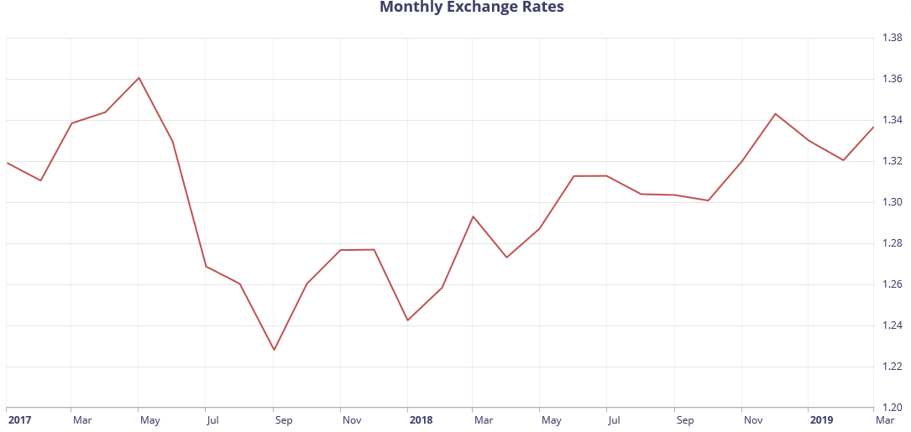
CDN vs USD

Slide 5
Comprehensive and Progressive Agreement for Trans- Pacific Partnership (CPTPP)
  11 country trade partnership
    Japan, Malaysia, Vietnam, Singapore, Brunei, Australia, New Zealand, Canada, Mexico, Chile, and Peru
  7 countries have ratified. Remaining countries are working towards ratification
  Dec 30, 2018 agreement came into effect

Slide 6
CPTPP
  Important for agriculture
  Pork
  Japanese tariffs of 20% will be eliminated on pork products
  Vietnamese tariffs of 27% will be eliminated on pork
  Tariffs in Japan and Vietnam will be greatly reduced on beef as well as offal
  Canadian dairy markets will open another 3.25% to Asia-Pacific trading group

Slide 7
USMCA
The trade deal formerly known as NAFTA
  Began formal talks Aug 2017 final agreement reached Sept 30, 2018
  Known as US – Mexico – Canada Agreement, CUSMA, NAFTA 2.0
  Notable to ag:
    Opening another 3.9% of the Canadian dairy market to the US, which is more than they asked for in TPP negotiations
    Elimination of Class 6 and 7 milk
      Skim milk powder, diafiltered milk
    Further opening of Canadian chicken, egg, and turkey markets

Slide 8
USMCA
Barriers to completing the deal:
  Could take longer to ratify than to negotiate the agreement
  Aluminum/Steel Tariffs
  Canadian Election this fall
  US politics
  Mexico fatigue

Slide 9
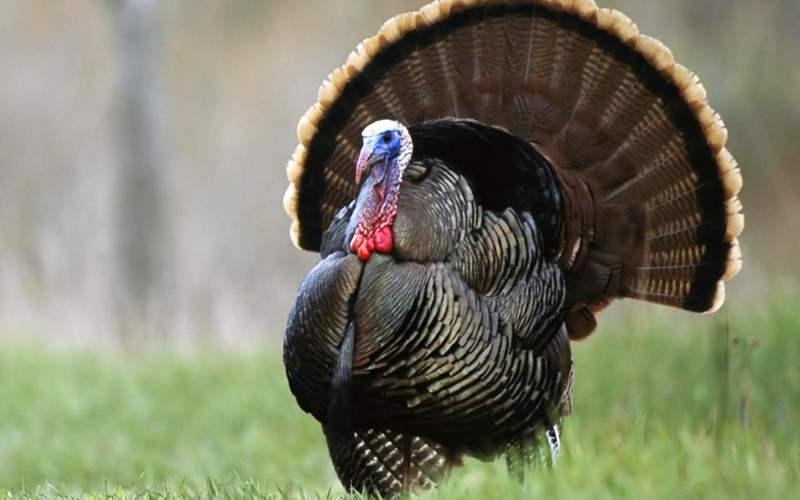
Industry Outlook 2019
Poultry
Outlook steady/good
Increasing consumer demand
Prices and consumption continue to improve
USMCA
Safe Guards
Understand the quota:
  Provincial legislation re: transferability.
  Debtor’s utilization and options to lease out quota.
  Understanding compensation rules will have bearing on security.
High land values may support security position

Slide 10
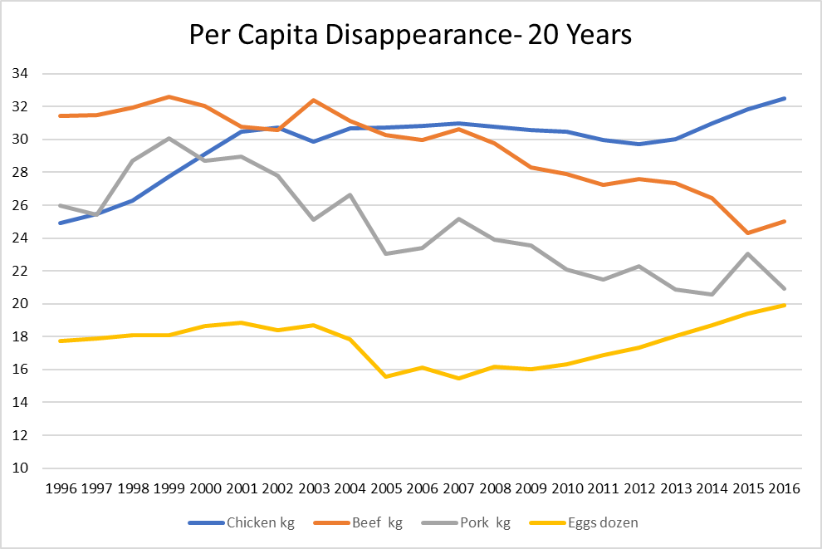
Industry Outlook 2019

Slide 11
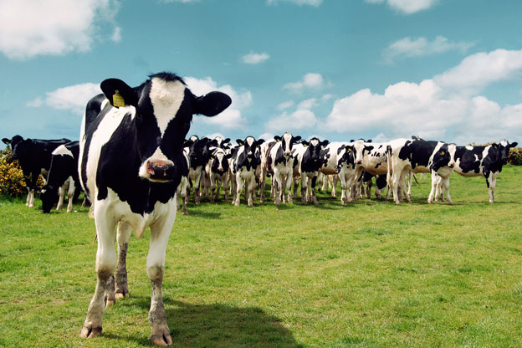
Industry Outlook 2019
Dairy
Demand for Butterfat
Quota Holdings Increasing
Consolidation
USMCA
  Class 7 Milk.
  World Market pricing
  Tariffs
Safe Guards
Understand the quota:
  Provincial legislation re: transferability.
  Debtor’s utilization and options to lease out quota.
  Understanding compensation rules will have bearing on security.
High land values may support security position

Slide 12
Industry Outlook 2019
Crops
Outlook on pricing
Seeding Intentions
Trade
Weather
Safe Guards
Equipment ratio on grain farms is important.
Ensure all property of creditor included on debt security
Verify proper registration on land and related farm equipment
Verify crop insurance & AgriStability status

Slide 13
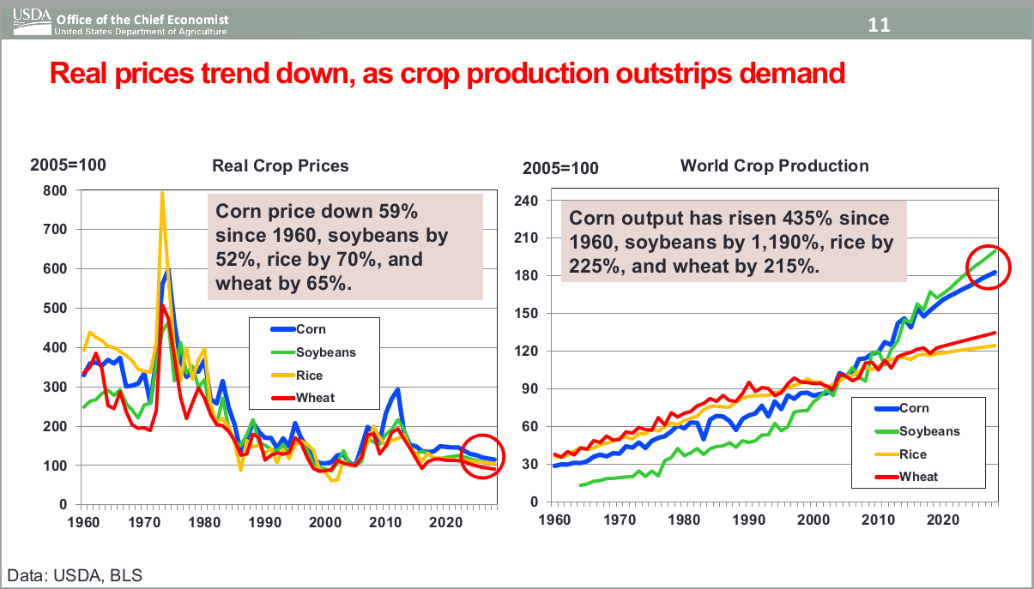
Industry Outlook 2019
Safe Guards
Equipment ratio on grain farms is important.
Ensure all property of creditor included on debt security
Verify proper registration on land and related farm equipment
Verify crop insurance & AgriStability status

Slide 14
Industry Outlook 2019
Crops
Canola
  China/Canada
Soybean
  China/USA
Corn
Wheat
Safe Guards
Equipment ratio on grain farms is important.
Ensure all property of creditor included on debt security
Verify proper registration on land and related farm equipment
Verify crop insurance & AgriStability status

Slide 15
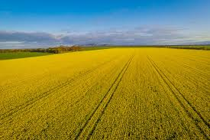

Grain Production - Canada
Stat’s Can report (Dec. 2018)
  Second largest soybean production – 7.3 million tonnes
    2.6% decrease from 2017
      Drought conditions
  Second largest canola production – 20.3 million tonnes
    1.5% decrease from 2017
      Increase in harvested area but drought
  Second largest wheat production – 31.8 million tonnes
    3.3% increase over 2017
      Increased acres
Notes:
-Canola – affected by Chinese Huawei
-Richardson targeted as it’s a pure Cdn owned company
-The big news of the moment is the Chinese decision to expand its restriction on buying canola from just Richardson International to all Canadian companies. Canola accounts for half of Canadian agricultural trade with China, worth approximately $3.6 billion

Slide 16
Seeded Acreage 2019F
Notes:
Seeding intentions could be affected by ‘bomb cyclone’ in Midwest.
Switch to more beans due to shorter maturity
Wet fall in US = less fertilizer
Can’t move enough fertilizer in spring might force acres from corn to beans
Carry-over Wheat 1.025 vs 1.099
Soybean 900million vs 438 last year
Corn 1.8 billion vs 2.14 last year

Slide 17
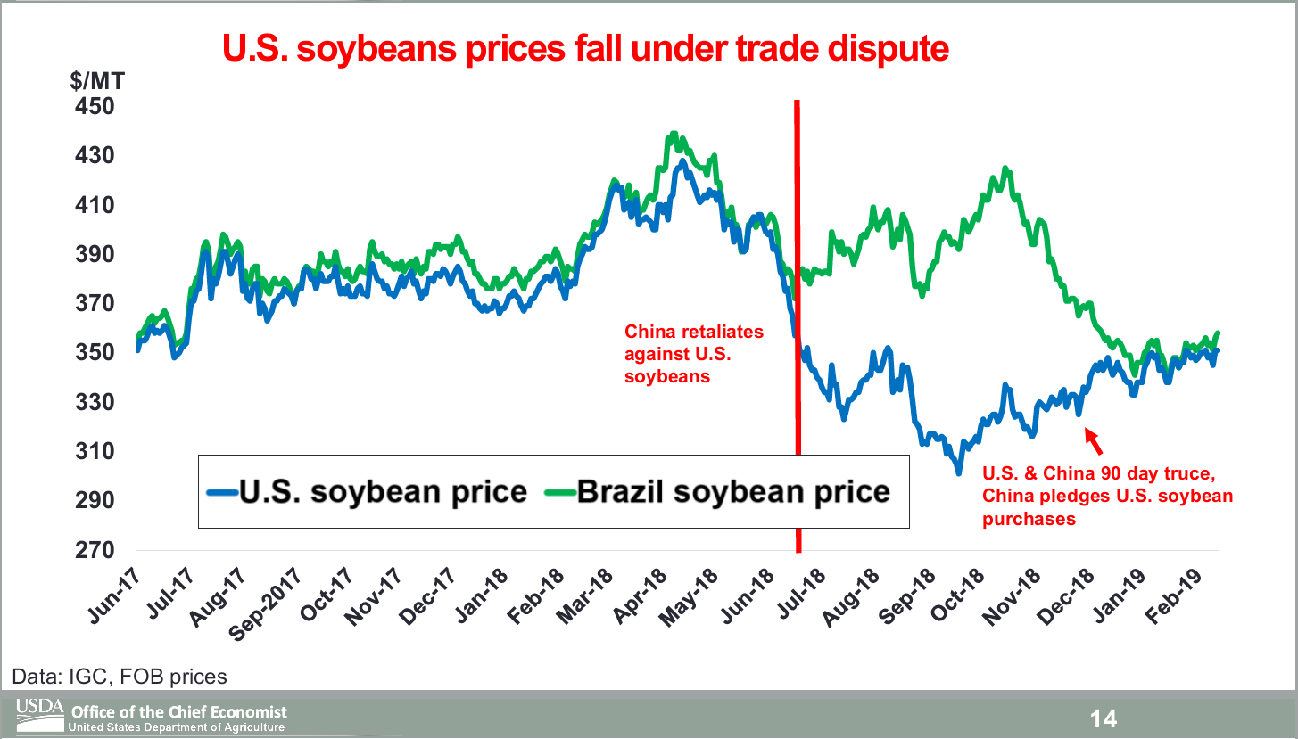
Industry Outlook 2019

Slide 18
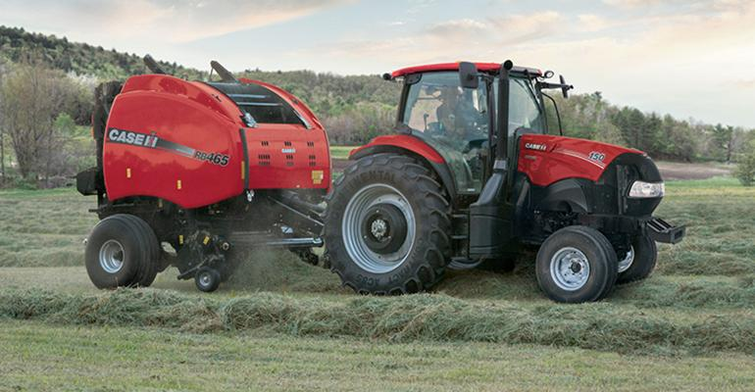
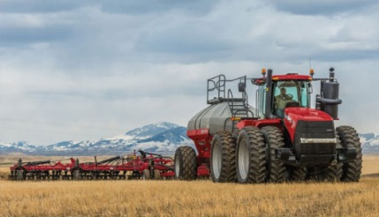
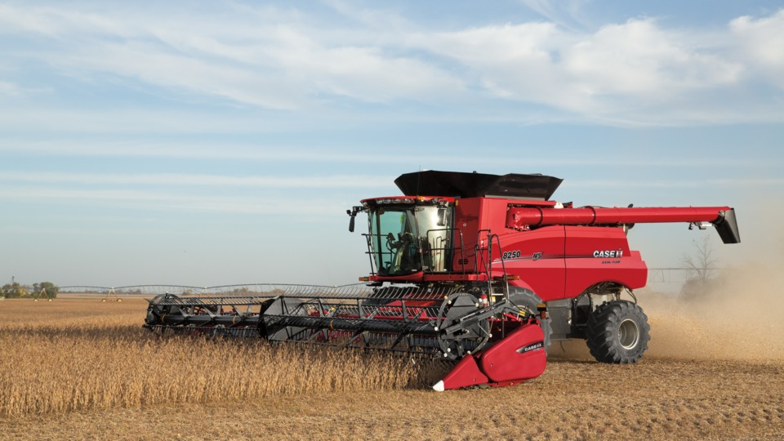
Farm Equipment
Lower machinery purchases overall
  2WD farm tractors down 30% YOY
  4WD farm tractors down 41% YOY
  Combine sales up 27% YOY
Notes:
Carbon tax – Farm Fuel Exempt
Affects competitiveness on global stage
Cardlock fuel now exempt as well
US steel duties potentially impacting price of machinery – time lag
Lots of used equipment being sold by large auctioneers like Ritchie Bros.

Slide 19
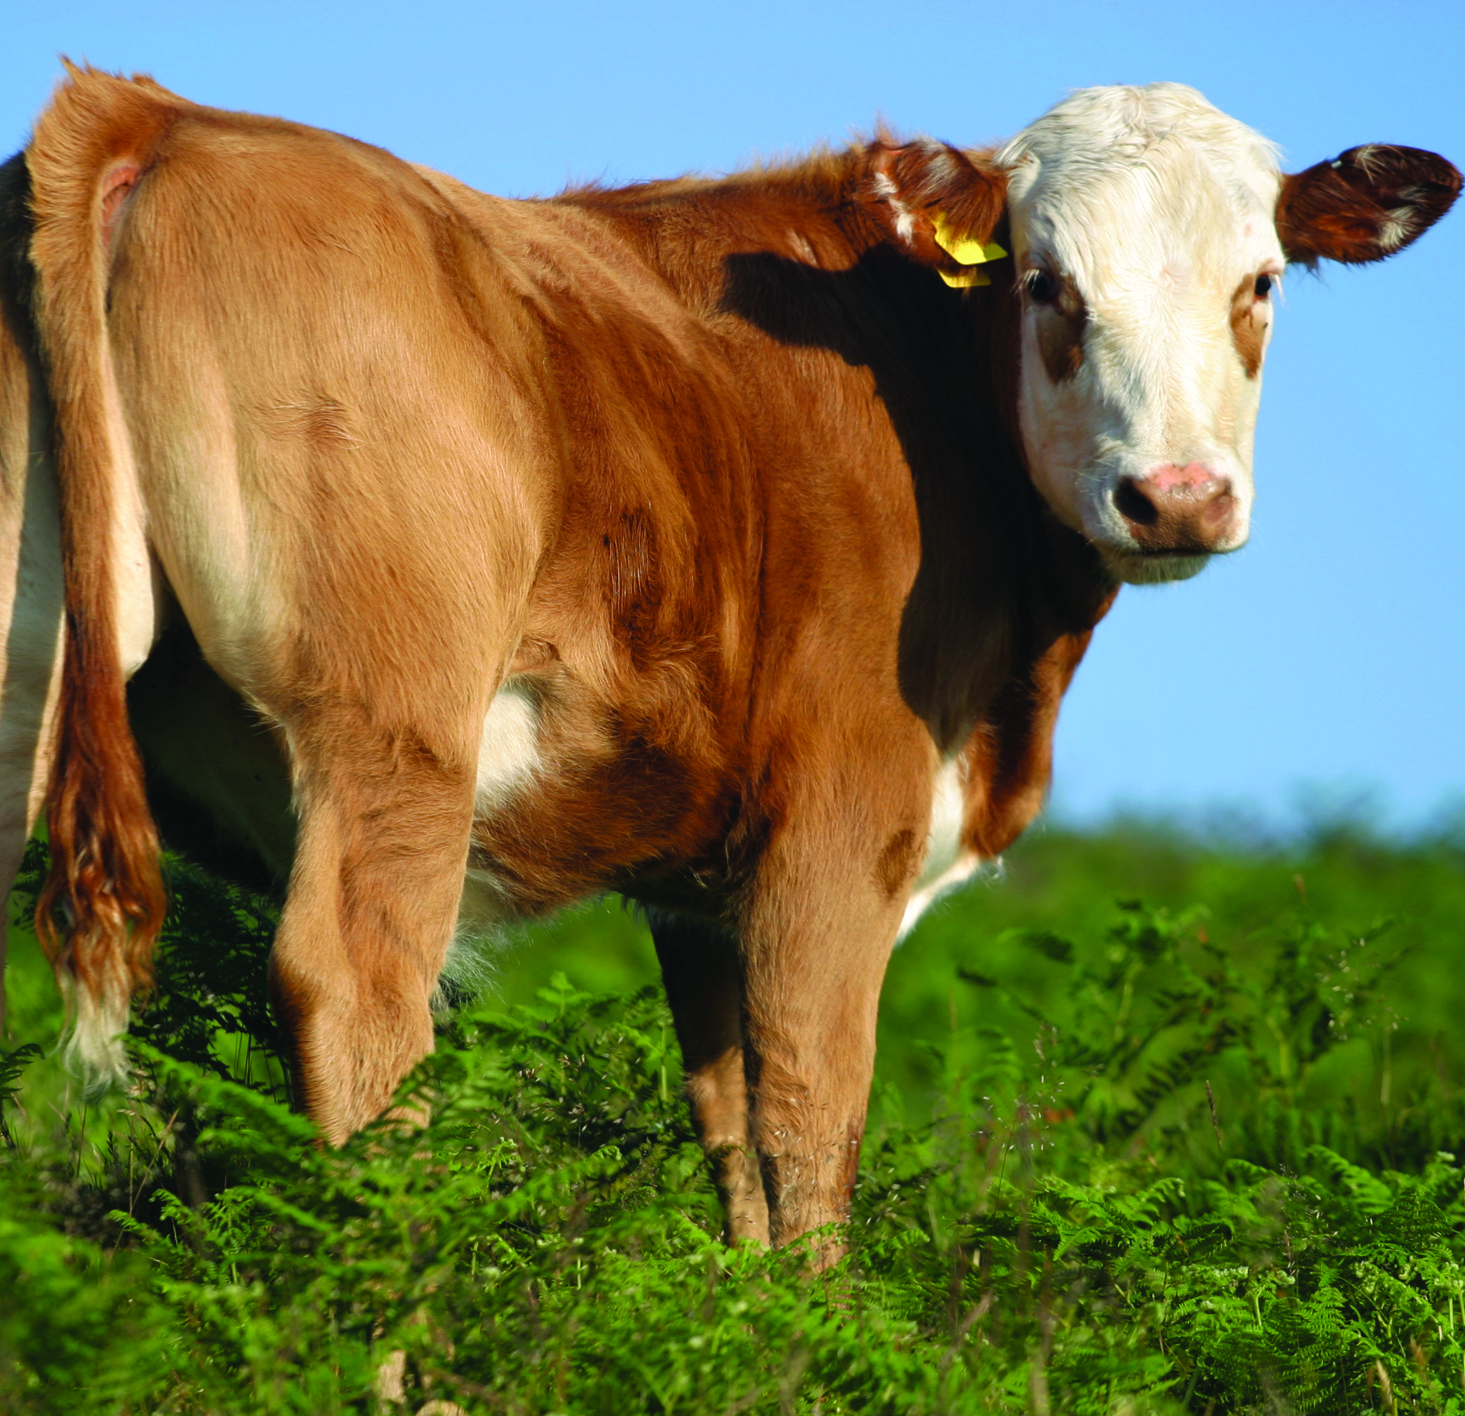
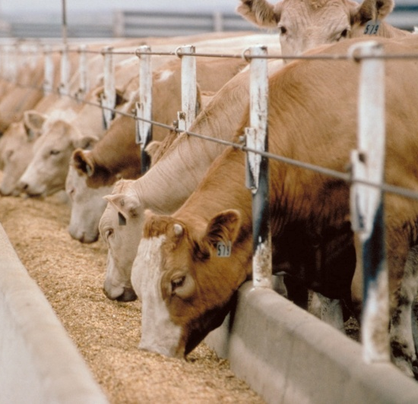

Industry Outlook 2019
Hogs
Projected Profitable Year
Feed costs rising - corn
Trade
Disease pressure
  PEDv
  ASF
Safe Guards
Perform walk-through on short notice and assess condition of
herd and barn operations
Verify proper registration on land and related farm equipment
Verify AgriStability status.

Slide 20
Hog Production
African Swine Fever
Fatal to hogs of all ages
Spread likely through humans (Belgium, Taiwan)
China has 433 million hogs (half world population)
112 cases and 1 million hogs have been culled in China due to ASF officially (3-500 cases and 5 million culled unofficially)
Retail prices increased 20% last few weeks in China
1 million lbs of illegal pork caught trying to enter US
Notes:
Smithfield!! – Tarriff collected by China from Smithfield but China owns Smithfield – tariff is just recirculated

Slide 21
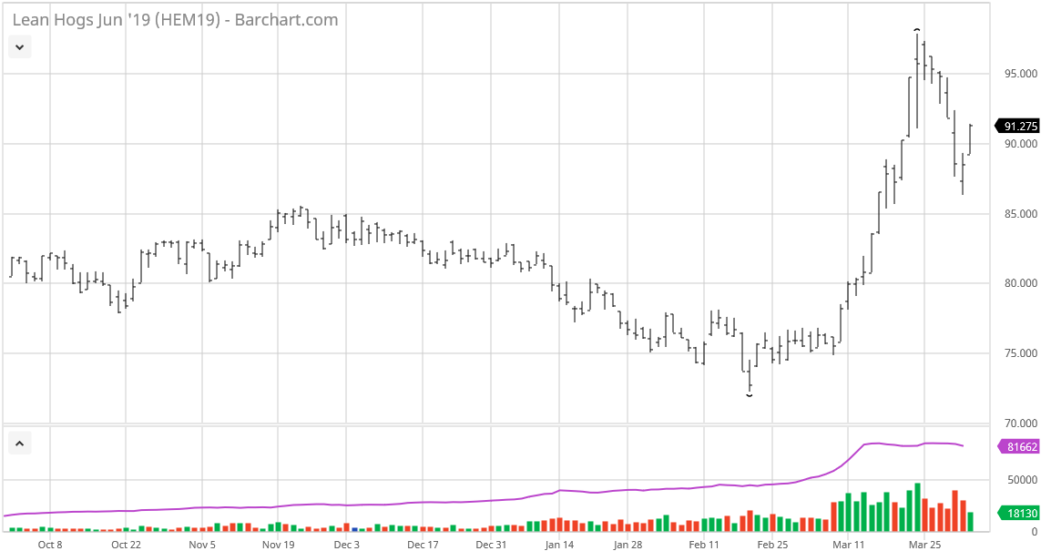
Hog Production
Insert slide showing limit up on hog prices recently

Slide 22
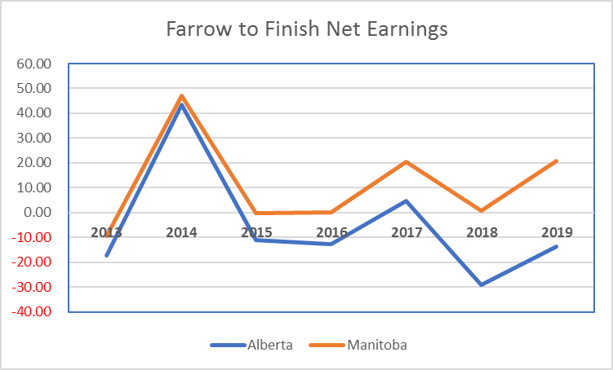
Hog Production
Notes:
Likely $20/head higher now

Slide 23
Industry Outlook 2019
Cow/Calf
US herd rebuilding and growing
  Midwest flooding
Stability in Canada
Herd growth plateaued
Modest profit margins
Safe Guards
Perform walk-through on short notice
Verify inventory and require manifests and/or proof of purchase or sale. Look closely at inventory values.
Verify AgriStability and risk management practices.

Slide 24
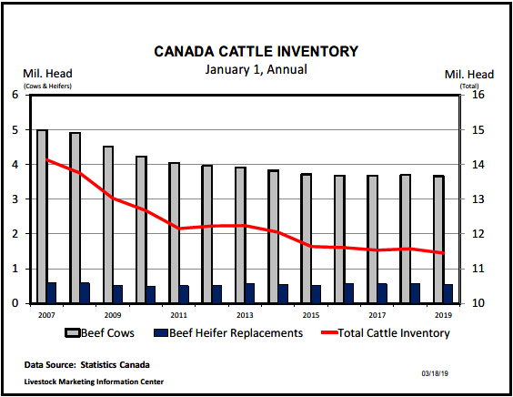
Industry Outlook 2019

Slide 25
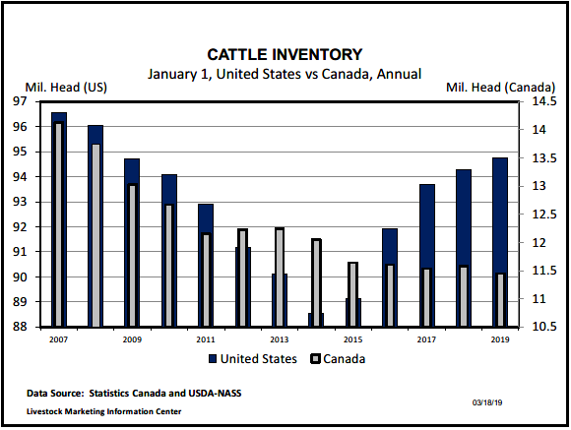
Industry Outlook 2019

Slide 26
Industry Outlook 2019
Feedlots
2019 seeing US market pressure
Feedlot space at a premium
Potential alternative to pork in China (ASF)
Regulatory environment
Trade
Safe Guards
Verify inventory and require manifests and/or proof of
purchase or sale
Verify AgriStability status and CPIP contracts
Ensure lands properly captured in loan documents and
registered at land titles
Check risk management practices. Scrutinise business plans.
Notes:
Demand will continue to support growing supplies but not without some price decline.
CPTPP – trade deals normally see long term to see affects.
CPTPP – in place Dec 30 – trade up 7% and value up 20% in first two months to Japan
Starting to outcompete US in Japan for beef

Slide 27
Industry Outlook 2019
Beef – Trade
CPTPP
  Already positive impacts since Dec 31
  Outcompeting U.S. in Japan market
CETA
  EU exports doubled in volume and value
  Challenge getting herds EU certified by CFIA vets
Mercosur
  Concern that it could open the door to Brazilian beef
Notes:
-market pressure from US keeping prices down
-demand for protein increasing, hoping to be an alternative source to pork if pork is in short supply (ASF)
-last 10 years has seen ongoing consolidation of smaller feedlots
-feedlot pen space is starting to be tight.
-herd up 10% in the west
-larger operators looking to diversify and set up new operations in US due to lower regulations to set up new operations ( 2 months in Texas)

Slide 28

Industry Outlook 2019
Wineries
Consolidation/Acquisition activity has slowed
Demand for quality vineyard property strong
  Controlling productive assets long term
Ice Wine harvest
Safe Guards
Verify Inventory (and value in-use).- sample to ensure quality.
Confirm terms of licences to produce and sell are being met.
Seek rolling 5 year plans/third-party input – primary downfall is cash and
inventory management.
Notes:
Comeau Case
Comeau vs R aka The New Brunswick Beer run
Provincial Court found New Brunswick Liquor Act Provisions Unconstitutional
Supreme Court of Canada has not ruled on this issue since 1978
Most current judges have never opined on s. 121 of the Constitution
The Supreme Court will be ruling on the constitutionality of inter provincial trade barriers (decision expected anytime)
2 separate groups were granted intervener status on behalf of the Canadian Wine industry – the Canadian Vintners Association (CVA) and a separate group of five BC wineries
The hope is that the outline of this case will be a catalyst towards free movement of Canadian wine between provinces. This is a very important outcome for small wineries in particular which rely on the ability to ship direct-to-consumer
A favorable outcome could start the wheels in motion for free trade between provincials. Provinces will get to set the rules but will have to keep within the spirit of the expected ruling
The ability to sell direct to consumers in other provinces is critical to smaller estate wineries
WTO Challenges
WTO challenges from the US & Australia could result in reduced trade barriers for international wines entering the Canadian domestic market. Canadian is one of the fast growing wine drinking nations and seen as an attractive market for other wine producing countries
Result could be increasing competition from low cost, good quality international wines
Industry groups are defending the status quo
M&A Activity
2017 activity has created a buyer’s market as current winery & vineyard
Land prices are reaching record highs

Slide 29

Industry Outlook 2019
Marijuana
Working on figuring out the model in Canada
Still heading towards Commoditization but haven’t got there yet
Supply Issues??
Joint Ventures with Food and Beverage
Safe Guards
Ensure all property of creditor included on debt security.
Confirm terms of licences to produce and sell are being met.
Confirm key individuals named in licences are tied to the company.
Notes:
Aurora has the biggest manufacturing facility in Canada just outside Edmonton
Need to perfect distribution model, retail model, dynamics around consumer demand
Supply – sufficient supply to meet Canadian demand but inefficiencies in supply chain – logistics, workflow, distribution
Wpg example – stores with shortened hours, limited variety etc
Food and Beverage – consultation period with government is over – industry waiting to hear back what the regulations will look like
still trying to figure out supply chain for that emerging industry as well

Slide 30
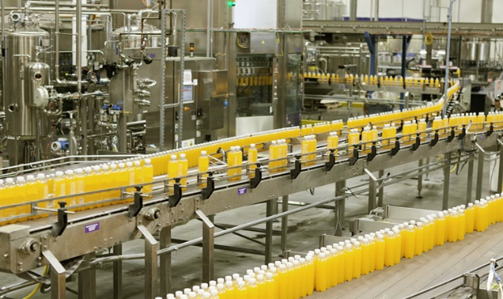
Industry Outlook 2019
Food and Beverage
2nd largest manufacturing sector in Canada
Trade
Foreign Exchange
  Works in favor of Cdn industry
Safe Guards
Ensure all property of creditor included on debt security.
Confirm terms of licences to produce and sell are being met.
Confirm key individuals named in licences are tied to the company.
Notes:
FX – barriers right now are access to capital to meet growing demand and access to human resources to produce product.
Trade – all good for this industry – further processed goods is a huge opportunity for Canada right now. TPP, CETA. USMCA all net positive for Food and Beverage
Industry is a priority for Gov’t right now
clustering strategy
funding/grants for innovation and technology are a priority
2nd largest mfg sector in Canada is Food and Beverage – centered in Ontario and Quebec
Trend toward assembled and packaged food in grocery stores– take home and prepare/take home and heat/take home and eat
seen in larger centres right now/trending across Europe already

Slide 31
Contacts
Farm Management Consulting
John Loeppky , P. Ag
Direct: 204.336.6148 Cell: 204.381.3260
john.loeppky@mnp.ca
Corporate Recovery Services
Victor Kroeger, CPA,CA,LIT,CIRP, CFE
Direct: 403.298.8479 Cell: 403.870.1827
vic.kroeger@mnp.ca

Slide 32
Appendices – Our People
The MNP Advantage:
Offices in strategic urban and rural locations from coast-to-coast
Experience with 18,000 commercial and 300 Hutterite Colony farm clients
Over 60 years service to agriculture has given us unparalleled and unrivalled access to the industry from the producer level all the way up to industry associations and government.
Nobody does it better.

Slide 33
Appendices – Our People
“Think Global, Act Local”
Over 85 offices from coast-to-coast.
Member of Praxity Global Alliance of Independent Firms giving us worldwide presence
The only professional accounting firm with a dedicated Farm Management Consulting group
We have specialists located in the areas necessary to meet the needs of our agricultural clients

Slide 34
Appendices – Our People
Over 600 professionals focused on the agriculture industry with niche specialities in:
  Farm Management
  Crops
  Livestock
  Farm income stabilization programs
    AgriStability and AgriInvest
  Agriculture specific accounting & tax
  Food & Ag Processing
  Hutterite Colonies

Slide 35
Appendices – Our People
Farm Programs
Farm Programs are a complex and highly specialised service-line.
With several hundred file preparers preparing over 9,000 applications a year backed up by 100 internally certified specialists MNP is the only firm in Canada to:
  Take a full-service approach to Farm Programs.
  Develop a specialised team to maximise program-revenue for our clients.
  Prepare such a large volume of applications.

Slide 36
Appendices – Our People
Farm Programs
A Full-Service approach means that MNP does more than just complete the forms – we know what and how much we are applying for which means:
  We know when payments are wrong and when it is worth following up and/or appealing.
  We get what we claim 90% of the time.
  We have a robust track record of reviewing non-MNP prepared applications and collecting under-claimed amounts.
  Only firm in Canada with ability to analyse interaction between risk management programs enabling them to be truly used for risk management with our ARMP tool.

Slide 37
Appendices – Our People
The 25 professionals in MNP’s Farm Management Consulting group bring to bear a combination of on-the-farm experience and formal education
Education and experience include:
Bachelors of Science in Agriculture (B. Sc.)
Professional Agrologists (P. Ag)
Certified Agricultural Consultants (CAC)
Former and current farm managers and producers

Slide 38
Appendices – Our People
Within the Farm Management Consulting team we have niche professionals in:
  Crop production and marketing (dryland and irrigated)
  Intensive livestock production and marketing
  Supply managed (dairy and poultry)
  Commodity and food processing
  Exotics
  Greenhouse and Market Gardening
  Orchard Fruit

Slide 39
Appendices – Special Situations
Working closely with Corporate Recovery Services, the Farm Management Consulting team have assisted with the provision of:
  Initial assessment of a debtor
  Monitoring
  Restructuring
  Liquidation

Slide 40
Appendices – Special Situations
The Farm Management Consulting team has provided the following services to Corporate Recovery Engagements:
  Assisting with taking possession of farm operations
  Determining and executing strategies for ongoing operations
  Providing executive management of day-to-day farm operations
  Consulting on key decision points in farm operations
  Preparation of risk analysis and mitigation strategies
  Providing input into realization plans

