Slide 1
Farm Management Consulting
MNP Canadian Agriculture Industry Outlook 2020
John Loeppky P.Ag
April 2020

Slide 2
Ag Industry Outlook – Table of Contents
Canadian Agricultural Industry Outlook 2020
Market Fundamentals
US Dollar – US Trade
Poultry
Dairy
Crops
Hogs
Beef
Wineries
Cannabis
Food and Beverage
Contacts
Appendices
Our People

Slide 3
Industry Outlook 2020
The Market Fundamentals
Supply Chain
Production
Trade
Supply Management

Slide 4
Industry Outlook 2020
USD/CAD
Source: Bank of Canada

Slide 5
Industry Outlook 2020
Protectionist vs Global Trade
CUSMA
Ratified but not enacted
Set to start June 1??
Phase 1 US/China Trade Deal
$200 Billion
Logistical Congestion
Protectionist Wheat Market
Russia, Ukraine looking at export quotas to support domestic prices

Slide 6
Industry Outlook 2020
Canada’s response to Covid in Agriculture
Increase Farm Credit Canada’s lending abilities by $5 billion
Allowed a Stay of Default on cash advances that were due on or before April 30, 2020.
Extended AgriStability deadline to July 3
Did not put a hold or eliminate the carbon tax that increased by 33% on April 1.
Farmers are exempt from paying carbon tax on gasoline and diesel fuel but still pay it on propane and natural gas.

Slide 7
Industry Outlook 2020
Poultry
Outlook good for eggs
Broiler placements reduced by 15%
Risk Management Programs
Safe Guards
Understand the quota:
Provincial legislation re: transferability.
Debtor’s utilization and options to lease out quota.
Understanding compensation rules will have bearing on security.
High land values may support security position

Slide 8
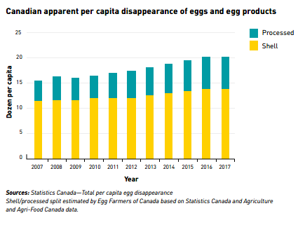
Industry Outlook 2020
Current consumption 253 eggs per capita per year
5 year goal of the industry is to move Canada to over 300 eggs per capita per year
Modelled after other countries like Mexico, China, Japan, Russia that currently have over 300 eggs per capita per year consumption

Slide 9
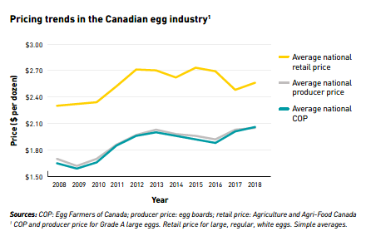
Industry Outlook 2020

Slide 10
Industry Outlook 2020
Dairy
Consumer demand shifting
Quota holding stable for now
Margins tightening
Risk Management Programs
CUSMA
Safe Guards
Understand the quota:
Provincial legislation re: transferability.
Debtor’s utilization and options to lease out quota.
Understanding compensation rules will have bearing on security.
High land values may support security position

Slide 11
Industry Outlook 2020
Expect COP to rise again in 2020.
2020 feed production critical
Price of purchased feed impacted by Covid-19
Fuel expense trending lower
Cull prices impacted by beef

Slide 12
Industry Outlook 2020
Crops
2019 Harvest….ongoing
Seeding Intentions
Farm Equipment Values
Farmland Values
Safe Guards
Equipment ratio on grain farms is important.
Ensure all property of creditor included on debt security
Verify proper registration on land and related farm equipment
Verify crop insurance & AgriStability status

Slide 13
Industry Outlook 2020
2019 harvest in 2020
Grain movement – excellent in the new crop year
Planting conditions impacted by delayed harvest
Crop inputs possibly delayed by supply chain disruption

Slide 14
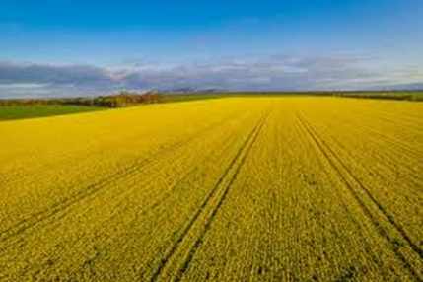
Industry Outlook 2020
Stat’s Can and AAFC estimates (as of March 19, 2020):
Wheat: 25.8 million acres (down 1%)
Canola: 20.5 million acres (down 2% yoy)
Corn: 3.6 million acres (down 2% yoy)
Soybeans: 5.6 million acres (flat)
Potatoes
2020 contracts reduced by 15-20%
2019 production at risk

Slide 15
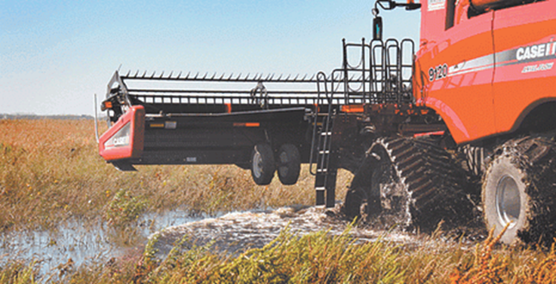
Industry Outlook 2020
Wheat: 44.7 million acres (down 1% yoy)
Lowest planting intention since 1919
Prices supported by protectionist policy
Corn: 96+ million acres (up 8% yoy)
Largest since 2012
Ethanol demand 40% historically
Pressure on pricing
Soybeans: 83.5 million acres (up 10% yoy)
Large carryover still impacting prices

Slide 16
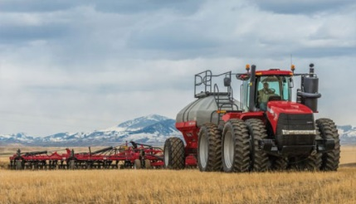
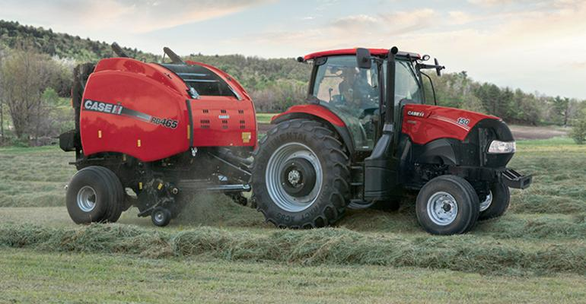
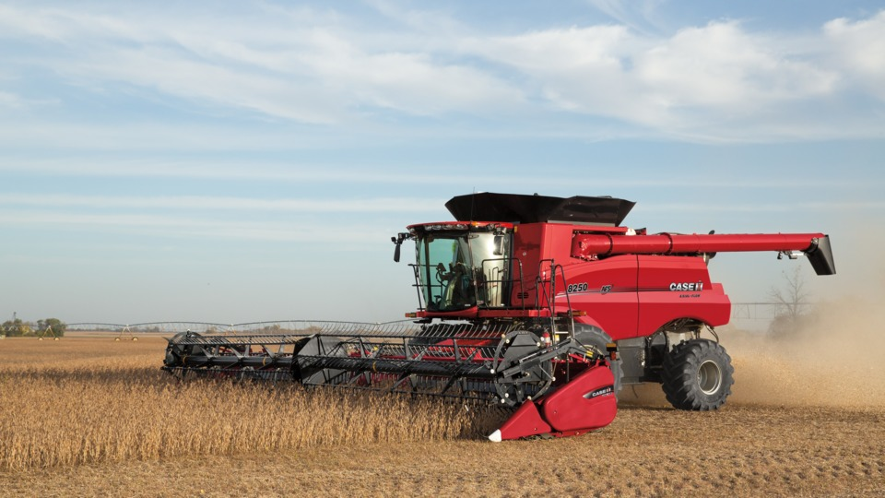
Industry Outlook 2020
Lower machinery purchases overall continue
4WD tractors down 19% yoy
2WD tractors down 23% yoy
Combine sales down 38% yoy
Favorable exchange rate causing increased interest from US buyers

Slide 17
Industry Outlook 2020
Canadian farmland value up 5.2% in 2019 (FCC)
Trend is still up but at a lower pace
Production challenges due to weather a factor
Low interest rate environment currently
Producers are cautious

Slide 18
Industry Outlook 2020
Hogs
Shifting demand
Plant closures
ASF
Safe Guards
Perform walk-through on short notice and assess condition of
herd and barn operations
Verify proper registration on land and related farm equipment
Verify AgriStability status.

Slide 19
Industry Outlook 2020
Cash isoweans prices have been drastically reduced with producers receiving $5/head or less
Many contracts producers had with US buyers are being cancelled
Summer prices for finished hogs, typically when prices are the highest, have also sagged on the collapse of US lean hog futures
Some producers are seeing close to $100/head less than this time last year. Many producers will be facing net losses on pigs shipped

Slide 20
Industry Outlook 2020
Plant Closures (US capacity 475,000/day)
Smithfield: South Dakota (20,000/day)
Missouri
Wisconsin
JBS: Minnesota (20,000/day)
Tyson: Iowa (10,000/day)
Olymel: Quebec

Slide 21
Industry Outlook 2020
African Swine Fever ongoing
Nearly 100% fatality for all hog ages
Sweeping through Southeast Asian countries
New cases had slowed at the end of 2019 but have increased in China lately.
Dozens reported in last two months

Slide 22
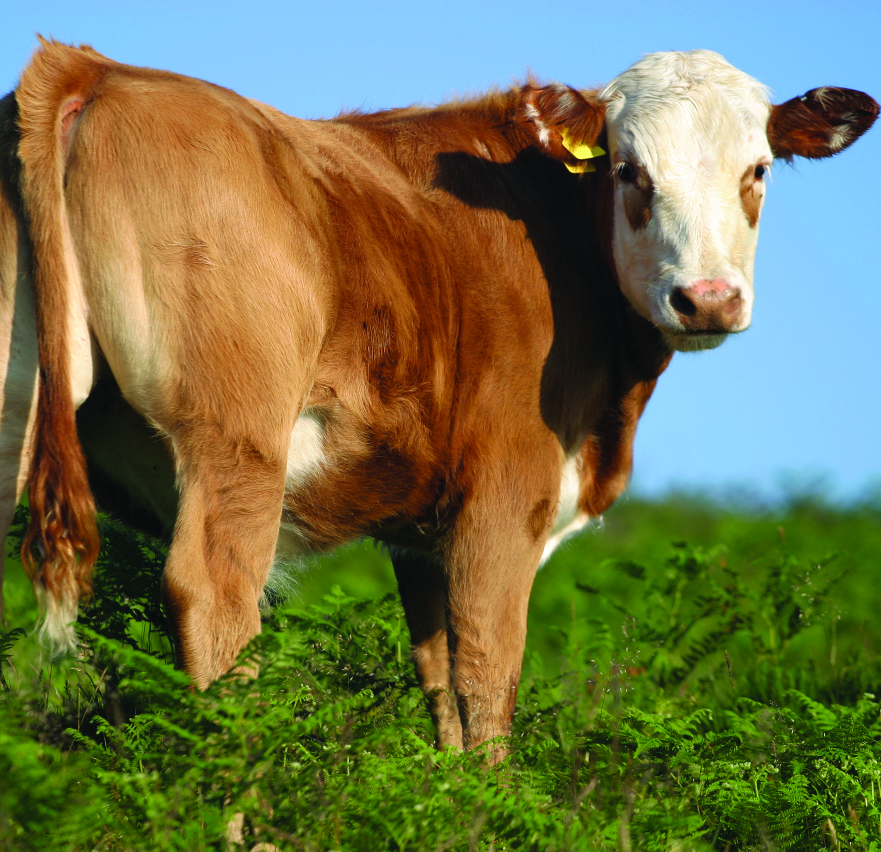
Industry Outlook 2020
Cattle
Supply chain disruption
Set Aside Program
Safe Guards
Perform walk-through on short notice
Verify inventory and require manifests and/or proof of purchase or sale. Look closely at inventory values.
Verify AgriStability and risk management practices.

Slide 23
Industry Outlook 2020
Cattle
Fed Cattle Pricing
Plant Closures
Safe Guards
Verify inventory and require manifests and/or proof of
purchase or sale
Verify AgriStability status and CPIP contracts
Ensure lands properly captured in loan documents and
registered at land titles
Check risk management practices. Scrutinize business plans.

Slide 24
Industry Outlook 2020
Plant Closures (USA)
JBS: Pennsylvania, Colorado
Cargill: Pennsylvania
National: Iowa, Kansas
Plant Closures (Canada)
Cargill: High River, AB
JBS: Brooks, AB
Harmony Beef: Balzac, AB

Slide 25
Industry Outlook 2020
Wineries
Restaurant closure impact
Supply chain disruptions
Employee/TFW impact
Safe Guards
Verify Inventory (and value in-use).- sample to ensure quality.
Confirm terms of licences to produce and sell are being met.
Seek rolling 5 year plans/third-party input – primary downfall is cash and
inventory management.

Slide 26
Industry Outlook 2020
Cannabis
Pre-pandemic sales stagnating
Continued commoditization
Stockpiling
Safe Guards
Ensure all property of creditor included on debt security.
Confirm terms of licences to produce and sell are being met.
Confirm key individuals named in licences are tied to the company.

Slide 27
Industry Outlook 2020
Food and Beverage
Shifting demand SKU
PPE for sector
Employee absenteeism
Safe Guards
Ensure all property of creditor included on debt security.
Confirm terms of licences to produce and sell are being met.
Confirm key individuals named in licences are tied to the company.

Slide 28
Contacts
Farm Management Consulting
John Loeppky , P. Ag
Direct: 204.336.6148 Cell: 204.381.3260
john.loeppky@mnp.ca
Corporate Recovery Services
Victor Kroeger, CPA,CA,LIT,CIRP, CFE
Direct: 403.298.8479 Cell: 403.870.1827
vic.kroeger@mnp.ca

Slide 29
Appendices – Our People
The MNP Advantage:
Offices in strategic urban and rural locations from coast-to-coast
Experience with 15,000 commercial and approximately 300 Hutterite Brethren clients
For more than 60 years, MNP has represented the interests of our clients and the Canadian agriculture industry in provincial and federal matters.
Nobody does it better.

Slide 30
Appendices – Our People
The MNP Advantage:
Offices in strategic urban and rural locations from coast-to-coast
Experience with 15,000 commercial and approximately 300 Hutterite Brethren clients
For more than 60 years, MNP has represented the interests of our clients and the Canadian agriculture industry in provincial and federal matters.
Nobody does it better.

Slide 31
Appendices – Our People
Over 600 professionals focused on the agriculture industry with niche specialities in:
Farm Management Consulting
Crops
Livestock
Agriculture Risk Management Resources (ARMR)
Ag Risk Management Projector (ARMP)
AgriStability
AgriInvest
GARS
JustSolutions
Industry-specific financial reporting methods & tax specialists
Food & Ag Processing
Hutterian Brethren
Succession Planning with MNP’s TransitionSMART

Slide 32
Appendices – Our People
Agriculture Risk Management Resources (ARMR)
One of the key considerations for any farm operator is risk management. With multiple risks to consider and various insurance programs to cover them, it can be overwhelming for clients to determine the best course of action regarding their farm’s risk management strategies. MNP’s Agriculture Risk Management Resources (ARMR) provides our clients with critical information so that they can grow their business while protecting and safeguarding it during challenging times. With ARMR and MNP’s Ag Risk Management Projector™, we help our clients understand and evaluate the best options for them, their business and their peace of mind.
MNP’s team of specialists draw on extensive research. They have long-term relationships with various levels of government and take a comprehensive approach to help our clients get the most from their risk management strategies.

Slide 33
Appendices – Our People
Our FMC team is made up of professional agrologists and consultants who come from extensive agriculture backgrounds, bringing a high level of technical expertise, firsthand knowledge and close relationships with the agriculture industry to every engagement.
Education and experience include:
Bachelors of Science in Agriculture (B. Sc.)
Professional Agrologists (P. Ag)
Certified Agricultural Consultants (CAC)
Former and current farm managers and producers

Slide 34
Appendices – Our People
Within the Farm Management Consulting team we have niche professionals in:
Crop production and marketing (dryland and irrigated)
Intensive livestock production and marketing
Supply managed (dairy and poultry)
Commodity and food processing
Exotics
Greenhouse and Market Gardening
Orchard Fruit

Slide 35
Appendices – Special Situations
Working closely with Corporate Recovery Services, the Farm Management Consulting team have assisted with the provision of:
Initial assessment of a debtor
Monitoring
Restructuring
Liquidation

Slide 36
Appendices – Special Situations
The Farm Management Consulting team has provided the following services to Corporate Recovery Engagements:
Assisting with taking possession of farm operations
Determining and executing strategies for ongoing operations
Providing executive management of day-to-day farm operations
Consulting on key decision points in farm operations
Preparation of risk analysis and mitigation strategies
Providing input into realization plans

